Slide 1


Web search basics (Recap)
User
Web crawler
Search
Indexer
Query Engine
The Web
Indexes

Slide 2
Query Engine
Process query
Look-up the index
Retrieve list of documents
Order documents
  Content relevance
  Link analysis
  Popularity
Prepare results page
Today’s question: Given a large list of documents that match a query, how to order them according to their relevance?

Slide 3
Answer: Scoring Documents
Given document d
Given query q
Calculate score(q,d)
Rank documents in decreasing order of score(q,d)
Generic Model: Documents = bag of [unordered] words (in set theory a bag is a multiset)
A document is composed of terms
A query is composed of terms
score(q,d) will depend on terms

Slide 4
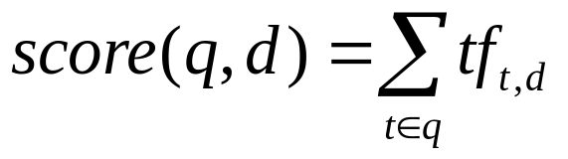
Method 1: Assign weights to terms
Assign to each term a weight
tf_{t,d} - term frequency (how often term t occurs in document d)
query = ‘who wrote wild boys’
doc1 = ‘Duran Duran sang Wild Boys in 1984.’
doc2 = ‘Wild boys don’t remain forever wild.’
doc3 = ‘Who brought wild flowers?’
doc4 = ‘It was John Krakauer who wrote In to the wild.’
query = {boys: 1, who: 1, wild: 1, wrote: 1}
doc1 = {1984: 1, boys: 1, duran: 2, in: 1, sang: 1, wild: 1}
doc2 = {boys: 1, don’t: 1, forever: 1, remain: 1, wild: 2} …
score(q, doc1) = 1 + 1 = 2 score(q, doc2) = 1 + 2 = 3
score(q,doc3) = 1 + 1 = 2 score(q, doc4) = 1 + 1 + 1 = 3
Notes:
Actually, none of the documents really answers the query. Doc1 says ‘sang’ and that doesn’t mean ‘wrote’
Ask whether they agree on the documents with the higher score.

Slide 5
Why is Method 1 not good?
All terms have equal importance.
Bigger documents have more terms, thus the score is larger.
It ignores term order.
Postulate: If a word appears in every document, probably it is not that important (it has no discriminatory power).

Slide 6
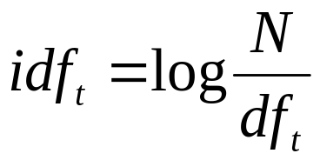


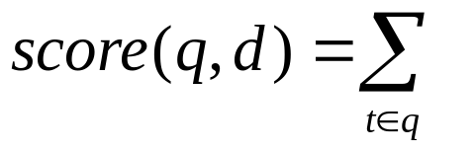
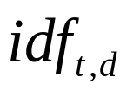
Method 2: New weights
df_{t} - document frequency for term t
idf_{t} - inverse document frequency for term t
tf-idf_{td} - a combined weight for term t in document d
Increases with the number of occurrences within a doc
Increases with the rarity of the term across the whole corpus
N - total number of documents
Notes:
Question: For which words tf-idf_{td} has a value of 0?
Answer: stopwords, that is words that appear in every document.

Slide 7
Example: idf values
terms | df | idf
1984 | 1 | 0.602
boys | 2 | 0.301
brought | 1 | 0.602
don’t | 1 | 0.602
duran | 1 | 0.602
flowers | 1 | 0.602
forever | 1 | 0.602
in | 2 | 0.301
it | 1 | 0.602
john | 1 | 0.602
terms | df | idf
krakauer | 1 | 0.602
remain | 1 | 0.602
sang | 1 | 0.602
the | 1 | 0.602
to | 1 | 0.602
was | 1 | 0.602
who | 2 | 0.301
wild | 4 | 0.0
wrote | 1 | 0.602
Notes:
Write on the board values for 1, 2, 3, 4 occurrences.

Slide 8
Example: calculating scores (1)
query = ‘who wrote wild boys’
documents | S: tf-idf | S: tf
duran duran sang wild boys in 1984 | 0.301 | 2
wild boys don't remain forever wild | 0.301 | 3
who brought wild flowers | 0.301 | 2
it was john krakauer who wrote in to the wild | 0.903 | 3
documents | S: tf-idf | S: tf
duran duran sang wild boys in 1984 | 0.426 | 2
wild boys don't remain forever wild | 0.551 | 3
who brought wild flowers | 0.301 | 1
it was john krakauer who wrote in to the wild | 1.028 | 3
Notes:
When df for ‘wild’ becomes 3, its idf = log10(4/3) = 0.125

Slide 9
Example: calculating scores (2)
query = ‘who wrote wild boys’
documents | S: tf-idf | S: tf
duran duran who sang wild boys in 1984 | 0.551 | 3
wild boys don't remain forever wild | 0.551 | 3
who brought wild flowers | 0.125 | 1
it was john krakauer who wrote in to the wild | 0.852 | 3
documents | S: tf-idf | S: tf
duran duran sang wrote wild boys in 1984 | 0.727 | 3
wild boys don't remain forever wild | 0.551 | 3
who brought wild flowers | 0.301 | 1
it was john krakauer who wrote in to the wild | 0.727 | 3
Notes:
Question: Why when we introduce ‘wrote’ the score for ‘duran-duran’ is higher than when we introduce ‘who’?
Answer: ‘who’ has a lower idf (log4/3) than ‘wrote’ (log4/2)
Question: Could you remember an indexing method that would have directly found ‘duran duran’ document as the best match for the query?
Answer: both the bigram index and the positional index.

Slide 10
The Vector Space Model
Formalizing the “bag-of-words” model.
Each term from the collection becomes a dimension in a n-dimensional space.
A document is a vector in this space, where term weights serve as coordinates.
It is important for:
  Scoring documents for answering queries
  Query by example
  Document classification
  Document clustering
Notes:
Question: How big is the vector space?
Answer: It will depend on the size of the vocabulary of the document collection.

Slide 11
Term-document matrix (revision)
 | Anthony & Cleopatra | Julius Caesar | Hamlet | Othello
Anthony | 167 | 76 | 0 | 0
Brutus | 4 | 161 | 1 | 0
Caesar | 235 | 228 | 2 | 1
Calphurnia | 0 | 10 | 0 | 0
Cleopatra | 48 | 0 | 0 | 0
The counts in each column represent term frequency (tf).

Slide 12
Documents as vectors
 | … combat | … courage | … enemy | … fierce | … peace | … war
HenryVI-1 | 3.5147 | 1.4731 | 1.1288 | 0.6425 | 0.9507 | 3.8548
HenryVI-2 | 0 | 0.491 | 0.7525 | 0 | 1.2881 | 7.7096
HenryVI-3 | 0.4393 | 2.2096 | 0.8278 | 0.3212 | 0.3374 | 16.0617
Othello | 0 | 0.2455 | 0.2258 | 0 | 0.2454 | 0
Rom.&Jul. | 0 | 0.2455 | 0.602 | 0.3212 | 0.5827 | 0
Taming … | 0 | 0 | 0 | 0 | 0.184 | 0
Calculation example:
N = 44 (works in the Shakespeare collection)
war df = 21, idf = log(44/21) = 0.32123338
HenryVI-1 tf-idf _{war}= tf _{war *} idf _{war} = 12 * 0.321 = 3.8548
HenryVI-3 = 50 * 0.321 = 16.0617
Notes:
Documents might share terms, and still not be similar. Thus, having a representation in vector space, permits us to calculate how near to each-other the vectors are.

Slide 13
Why turn docs into vectors?
Query-by-example
  Given a doc D, find others “like” it.
Now that D is a vector,
=> Given a doc, find vectors (docs) “near” it.
Intuition:
t₃
d₂
d₃
d₁
θ
φ
t₁
d₅
t₂
d₄
Postulate: Documents that are “close together”
in vector space talk about the same things.

Slide 14




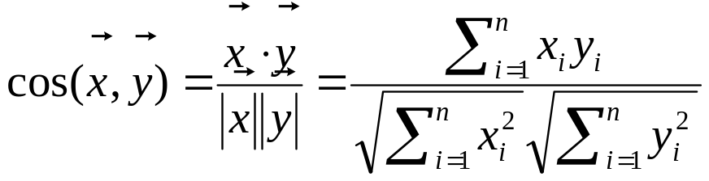
Some geometry
t2
cosine can be used as a measure of similarity between two vectors
Given two vectors and
d1
d1
d2
t1

Slide 15
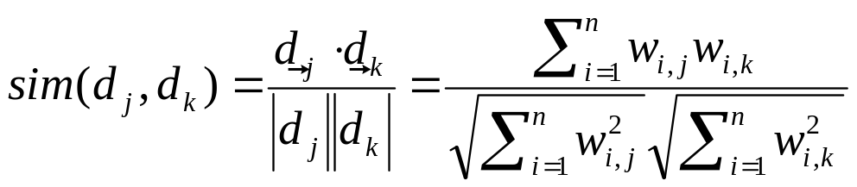

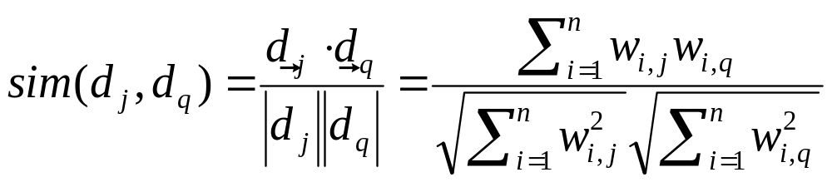
Cosine Similarity
For any two given documents d_{j} and d_{k}, their similarity is:
where is a weight, e.g., tf-idf
We can regard a query q as a document d_{q} and use the same formula:

Slide 16
Example
Given the Shakespeare play “Hamlet”, find most similar plays to it.
Taming of the shrew
Winter’s tale
Richard III
 | hor |  | haue
 | tf | tf-idf | tf | tf-idf
Hamlet | 95 | 127.5302 | 175 | 19.5954
Taming of the Shrew | 58 | 77.8605 | 163 | 18.2517
The word ‘hor’ appears only in these two plays. It is an abbreviation (‘Hor.’) for the names Horatio and Hortentio.
The product of the tf-idf values for this word amounts to 82% of the similarity value between the two documents.

Slide 17
Digression: spamming indices
This method was invented before the days when people were in the business of spamming web search engines. Consider:
  Indexing a sensible passive document collection vs.
  An active document collection, where people (and indeed, service companies) are shaping documents in order to maximize scores
Vector space similarity may not be as useful in this context.

Slide 18
Issues to consider
How would you augment the inverted index
to support cosine ranking computations?
Walk through the steps of serving a query.
The math of the vector space model is quite straightforward,
but being able to do cosine ranking efficiently at runtime is nontrivial

